Slide 1
JOB HUB
Presented By :Nirakar Bikram Rana And Saimundra Godar

Slide 2
ABSTRACT:
"JobHub" is a comprehensive web-based platform designed to address this challenge by serving as a seamless bridge between companies seeking to hire and individuals searching for job opportunities.
We present a platform named as JobHub, which is a college project website, with a primary objective to facilitate job posting by companies and empower job seekers with essential information about available positions.
JobHub aims to enhance the efficiency and transparency of the job market by providing a centralized hub for job seekers and companies to connect, exchange information, and explore employment opportunities.
Through this project, we hope to contribute to the advancement of online job recruitment systems and provide a valuable resource for college students and professionals seeking employment opportunities.
JobHub represents an innovative approach to job searching and hiring, making the process more accessible, transparent, and efficient for everyone.

Slide 3
INTRODUCTION:
JOB HUB is a web-based application/platform that connects job seekers with different employer.
This project involves creating a website that provides a user friendly interface for job seekers to search and apply for a job, and for employer to post job opening and review applications.
Job Hub includes full-time, part-time and contract based jobs.
This web-based application/platform will serve as a digital platform where job seekers and employer can register and connect with each other to facilitate the job opportunities.
This platform will provides a secure and user-friendly interface that allows for real-time communication.
Job Hub is a professional job board that helps the employer and job seeker to find their talents, dream jobs within a short time with its advanced search engine.
It comes with modern design and clean code to help you extend it further.

Slide 4
PROBLEM STATEMENT:
High competition in saturated job markets makes it difficult to secure positions, especially for entry-level candidates.
Employers often seek candidates with experience, leaving newcomers struggling to progress. Job seekers may possess skills that do not align with the current job market demands.This disconnect can make it difficult to find suitable employment and may necessitate retraining or up skilling.
As well as the Companies face several challenges when trying to find the perfect employee’s. These include skill shortages in specific industries, fierce competition for top talent, the need to adapt to rapidly changing skill requirements, These challenges require companies to implement effective recruitment strategies, invest in employee development, and leverage technology to streamline the hiring process and attract the best-fit candidates.
If the JOBHUB became a fully web-based platform then it helps to provide the job seekers with a centralized platform to access a wide range of job opportunities from various companies and industries. This increases the chances of finding suitable openings and reduces the time spent searching multiple sources, allowing job seekers to showcase their skills, education, and accomplishments effectively.
This helps employers identify talent beyond traditional work experience. In total JOB HUB would be beneficial for both job seekers and employers.

Slide 5
OBJECTIVE:
The aim and objectives of this project are :
To develop a web platform for job posting by companies and empower job seekers.
To contribute in the advancement of online job recruitment systems.
To encourage direct communication between job seekers and hiring companies.

Slide 6
IMPLICATIONS:
The proposed web-based application will serve as a digital platform where job seekers and companies register and connect with each other. The proposed application offers several benefits, including:
Contact Information: The platform facilitates direct communication between job seekers and hiring companies, promoting networking and personalized interactions.Contact Information: The platform facilitates direct communication between job seekers and hiring companies, promoting networking and personalized interactions.
Job Alerts: JobHub offers a job alert system, where users can set preferences and receive notifications about new job postings that match their criteria.
Feedback and Ratings: Users can provide feedback and ratings for companies they have interacted with, promoting transparency and accountability in the job market.
User Profiles: Users can create personal profiles, highlighting their skills, experience, and preferences. These profiles help companies identify suitable candidates and provide job seekers with a platform to showcase their qualifications.

Slide 7
LITERATURE REVIEW:
There are many web applications and mobile applications that have already been developed in the market place which provides a platform providing online job. Some of them are given below:
Kumari Jobs: Kumari Job Pvt. Ltd is a leading job site and human resources consulting firm that helps employers find the talent best suited for their business goals to improve overall performance since 2014.
JobsNepal: JobsNepal.com is the largest locally focused employment website in the nation. Their mission is to lead the internet employment industry in Nepal by providing innovative information, superior resume management software and comprehensive selection of services.they are the only requirement service provider with 100% free service to all the job seekers.
Jobejee: Jobejee is the fastest-growing job portal in Nepal. Find your career opportunities here. Search among thousands of jobs from top companies, industries, and locations of your choice. They have been providing services to the job seekers and Nepali companies since 2017.

Slide 8
TOOLS AND METHODOLOGIES:
REQUIRE TOOLS:
For the development of our project we will be using following tools:
Mysql: To add, access and process data stored in data base.
HTML,CSS: System for displaying material. Or how elements are to be displayed on screen.
JavaScript: To create a dynamic and interactive web page to interact with visitors and execute complex actions.
Php: To manage dynamic content.
Xampp Application: It is used or web application testing on a local host server.

Slide 9
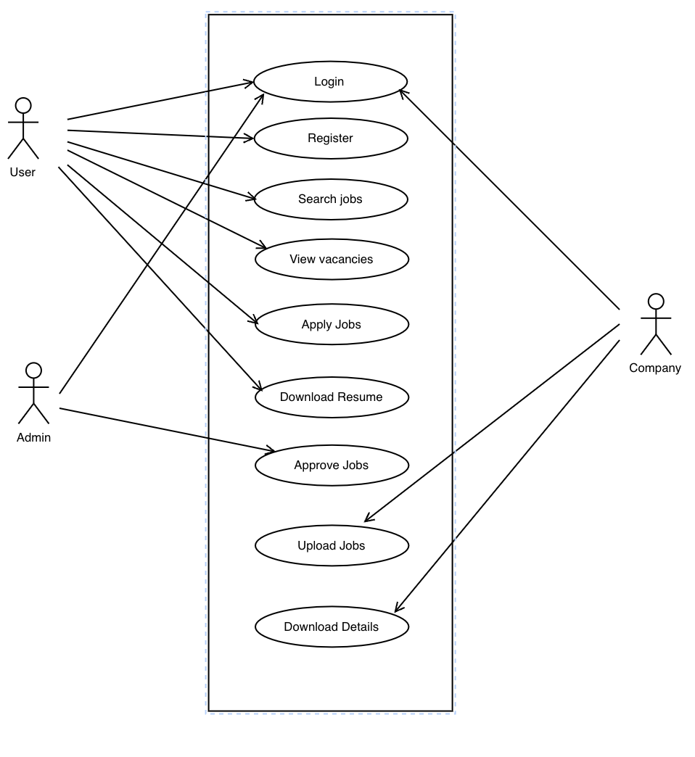
USE CASE DIAGRAM:
A use case diagram is a graphical depiction of a user’s possible interactions with a system. A use case diagram shows various use case and different types of users the system has and will often be accompanied by other types of diagrams as well.

Slide 10
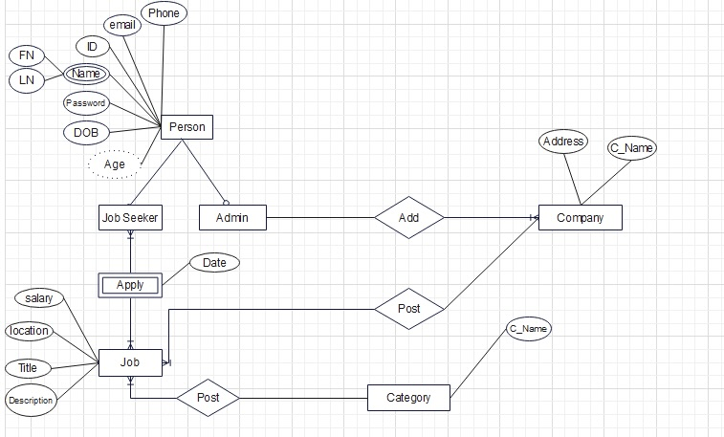
ENTITY RELATIONSHIP DIAGRAM:
An entity relationship diagram(ERD) is a graphical representation that depicts relationships among people, objects, place, concepts or events within an information technology(IT) system. An ERD uses data modeling techniques that can help define business process and serve as the foundation for relation data base.

Slide 11
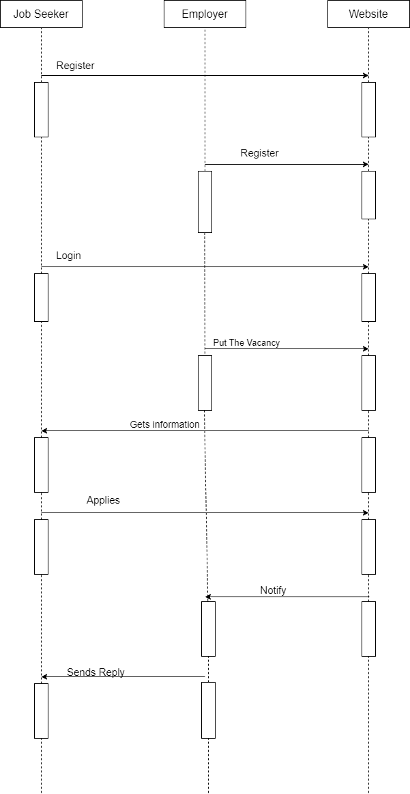
SYSTEM RELATIONSHIP DIAGRAM:
System Sequence Diagram are the interaction diagram that detail how operations are carried out. They capture the interaction between objects in the context of a collaboration. Sequence Diagrams are time focus and they show the order of the interaction by using the vertical axis of the diagram to represent time what message are sent.

Slide 12
EXPECTED RESULT:
Expected outcome is and ideal result that the organization should get after the successful completion of the project. The results are divided into 3 parts:
Outputs: This project creates a simple user-friendly and efficient interface that enables different companies to post their job vacancies application and helps to connect with many capable employees .
Outcome: This project connect companies and job seekers with a reliable accessible online platform.
Impact: There will be reduction in time that is separated to visit the company by the job seekers.

Slide 13
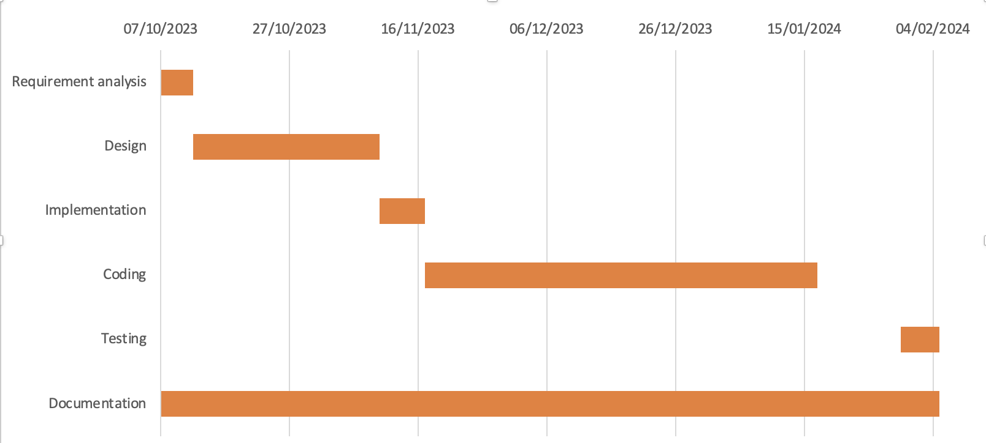
TIMELINE CHART:
Figure Timeline Chart for JOB HUB

Slide 14
BIBLIOGRAPHY:
Kumarijob(2023). Home Page. Retrieved from kumarijob: https://www.kumarijob.com/
JobsNepal(2023). Home Page. Retrieved from JobsNepal: https://www.jobsnepal.com/
Jobejee(2023). Home Page. Retrieved from jobejee: https://www.Jobejee.com/

Slide 15
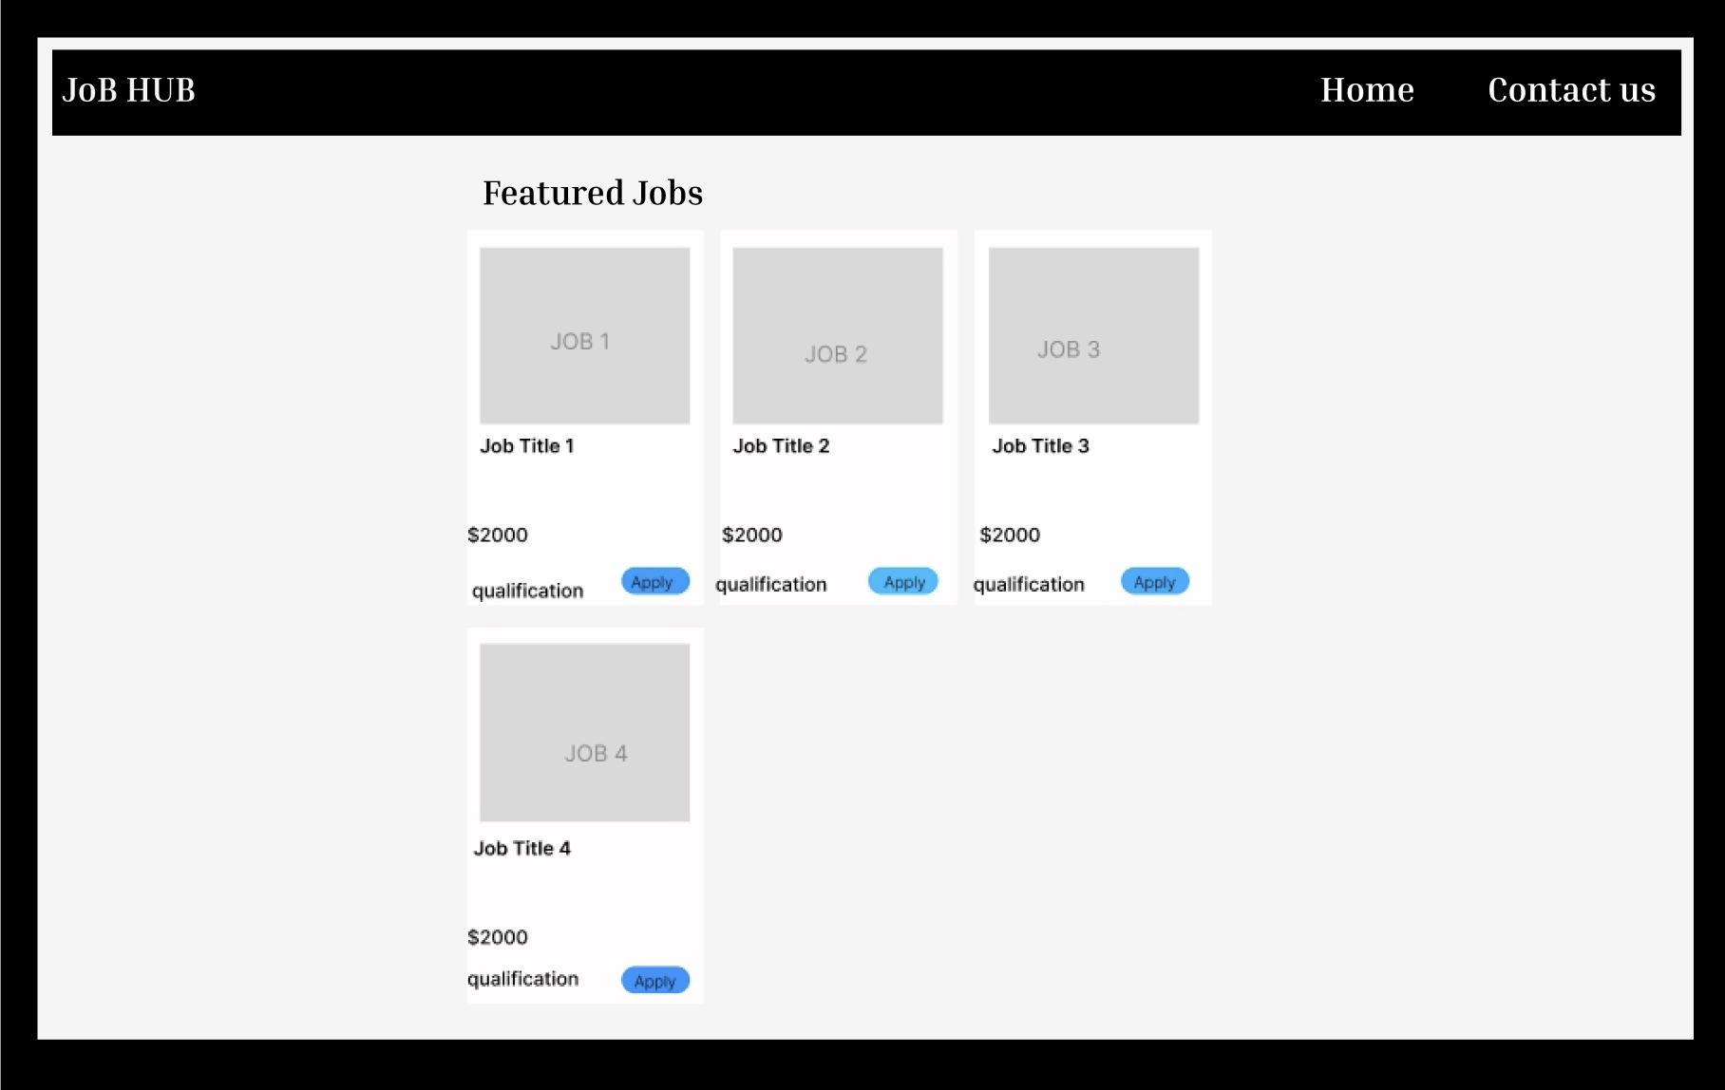
APPENDICES:
Figure : Wire-frame of Job lists

Slide 16
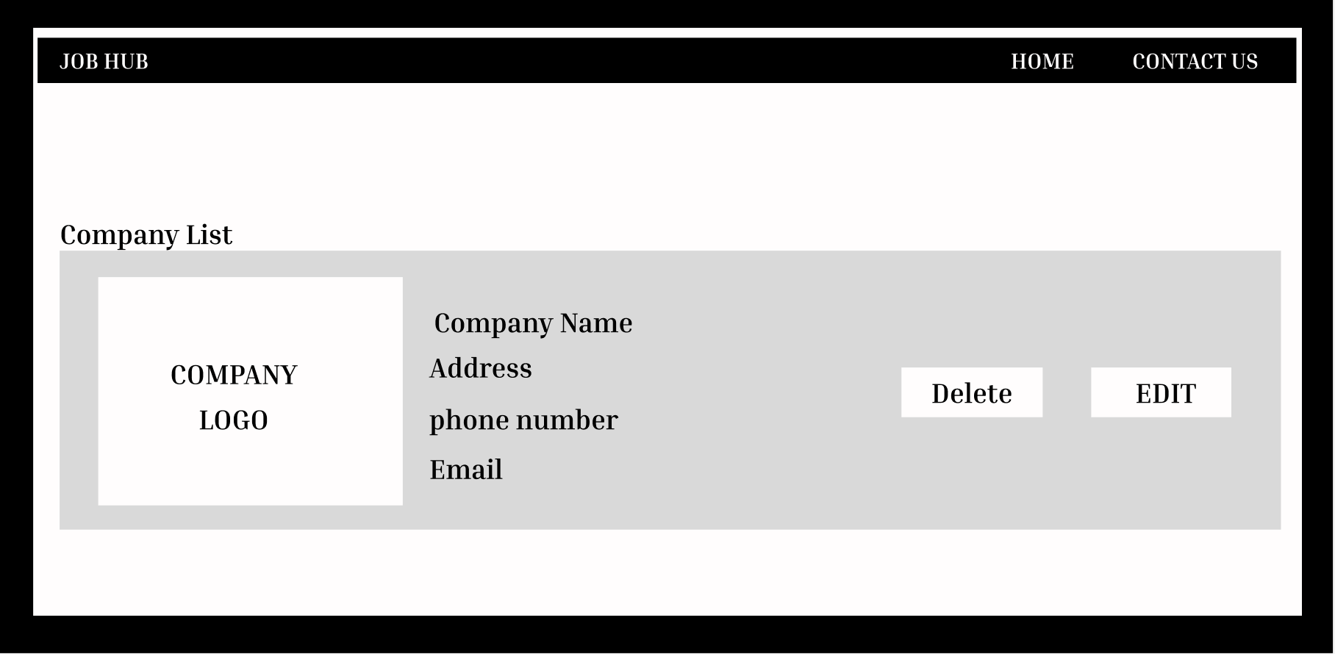
Figure: Wire-frame of Company List Page

Slide 17
THANK YOU

